Slide 1
Applied Deep Learning Final Project
Peter Grantcharov (pdg2116) Po-Chieh Liu (pl2441)

Slide 2
OVERVIEW

Slide 3
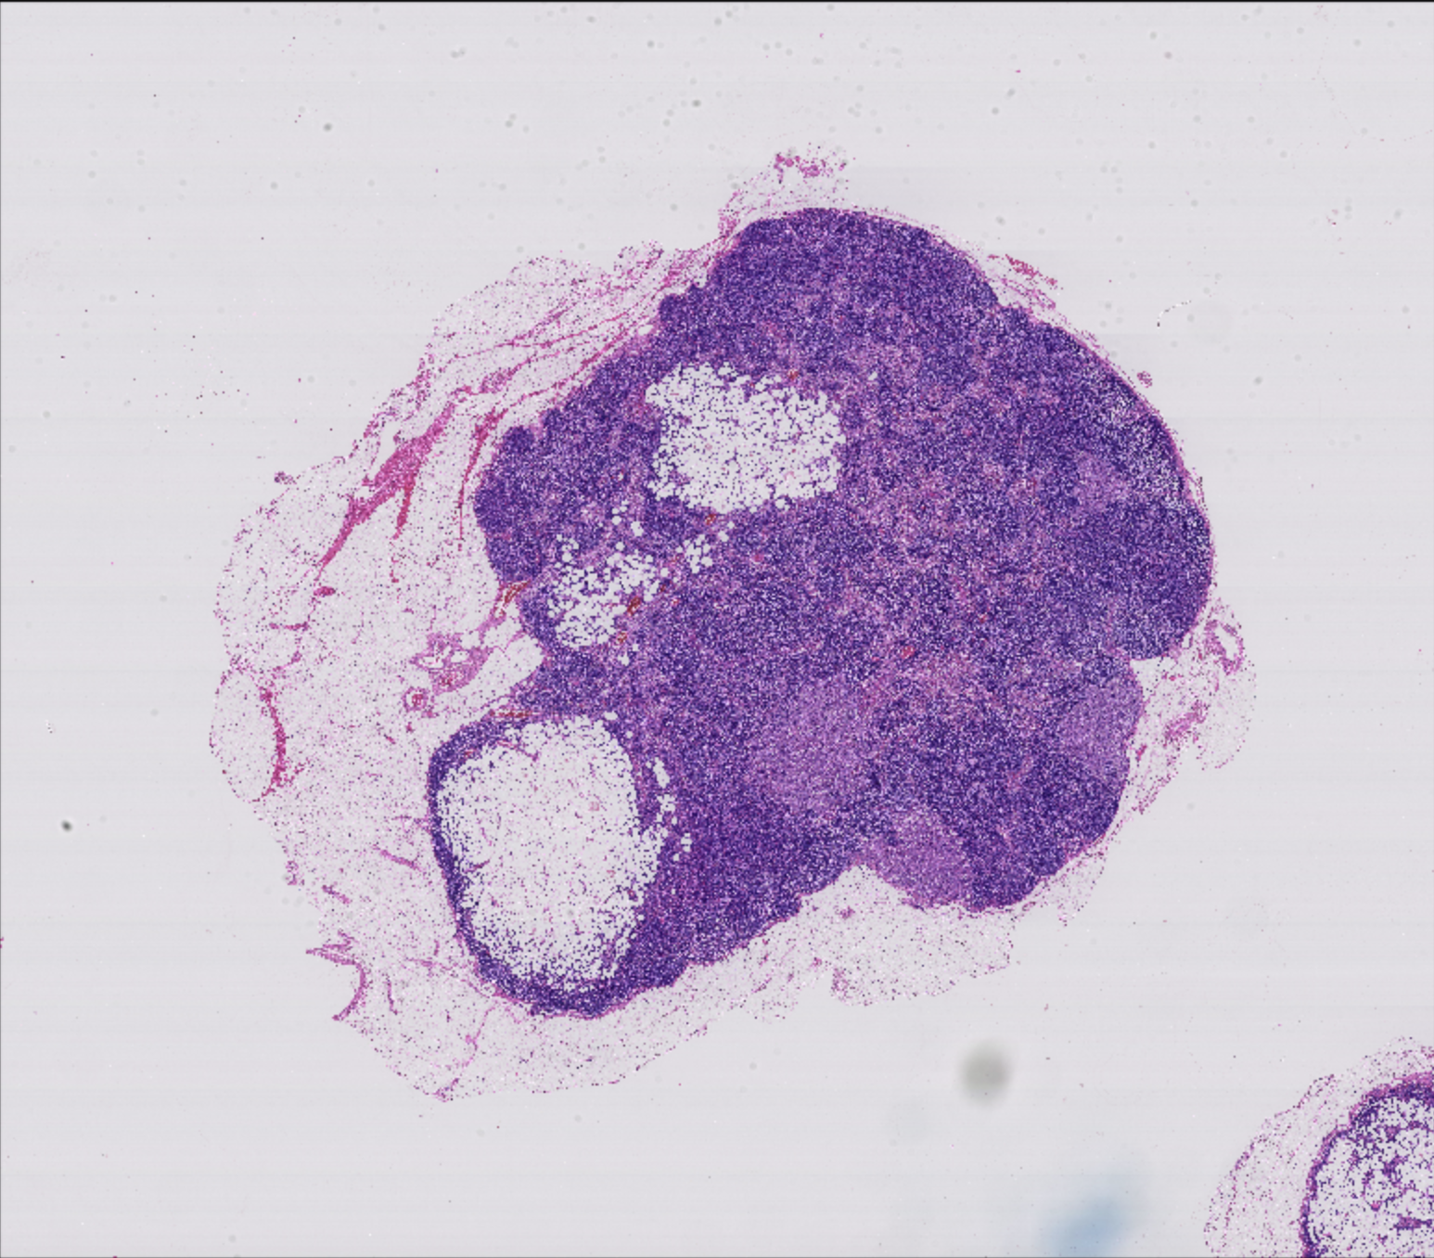

Objectives
Use deep learning to distinguish between cancer cells and healthy tissue cells from stained lymph node cross-sections
Dataset comprised of 21 labelled images at between 8-10 magnification levels
Sample Image
Cancer Cell Outline

Slide 4
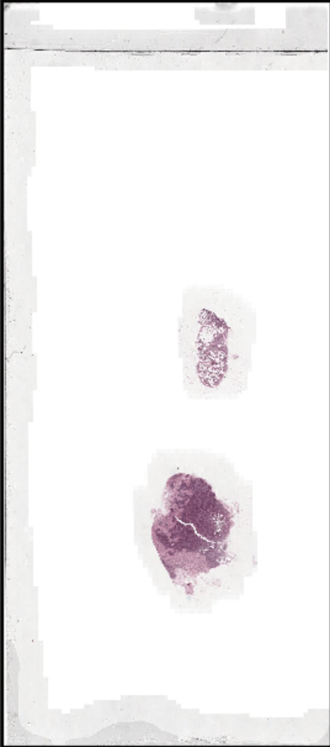
Ideas and Early Observations
Incorporate multiple magnification levels
Use transfer learning because of the dataset limitations
E.g. only have 21 images, limited compute resources, etc.
Use a sliding window to chop images, and train model to classify windows as cancers/non-cancerous rather than classifying full image
Vast amounts of blank space around tissue need to be treated / discarded

Slide 5
PRE-PROCESSING

Slide 6
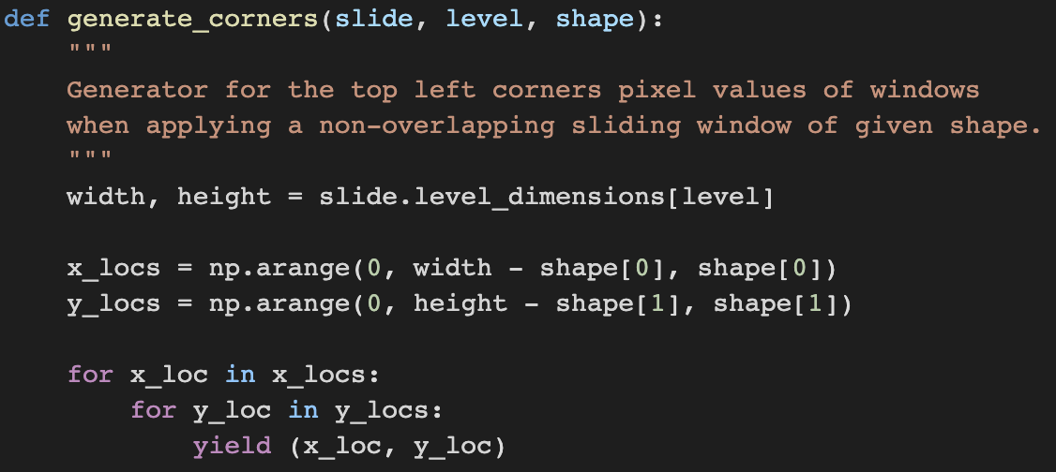
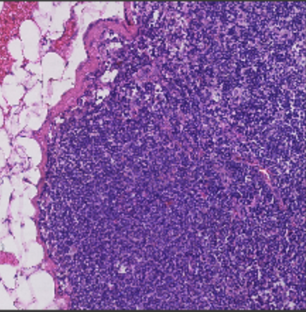
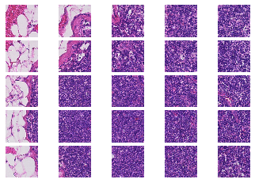
Sliding Window

Slide 7
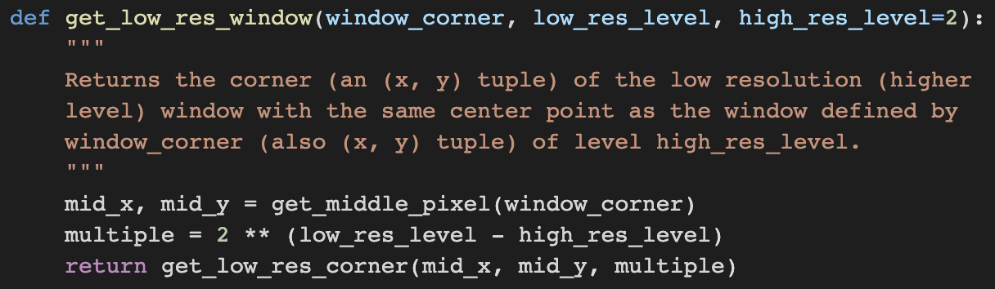
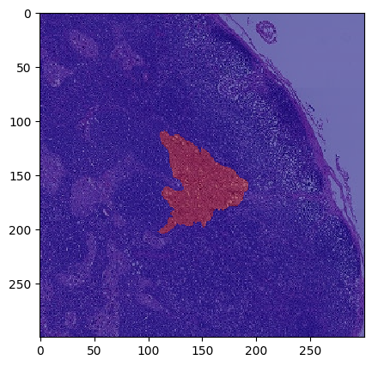
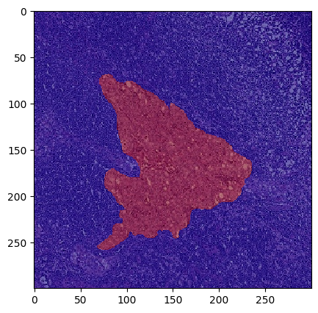
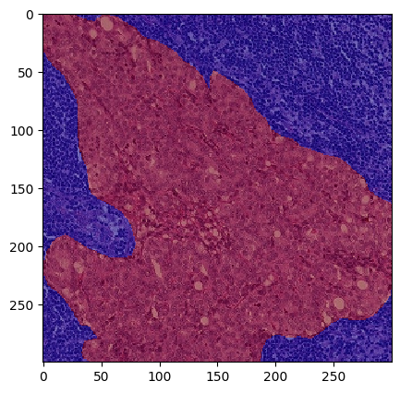
Align Different Magnifications
All images share same center point
Low resolution (high level) images were shifted so they didn’t include off-canvas regions

Slide 8
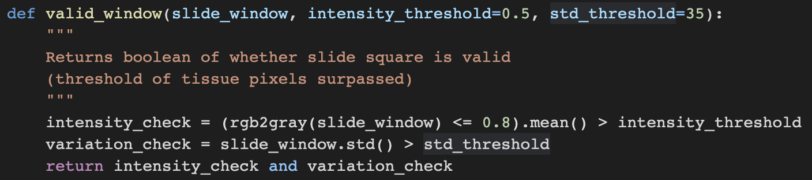

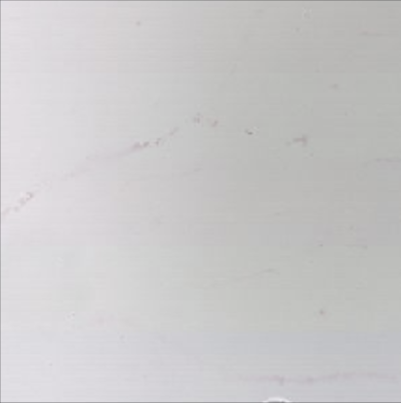
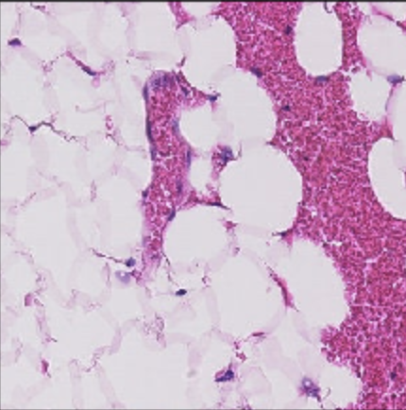
Discard Empty Space
INTENSITY CHECK: FAIL
VARIATION CHECK: FAIL
INTENSITY CHECK: PASS
VARIATION CHECK: FAIL
INTENSITY CHECK: FAIL
VARIATION CHECK: PASS
Added a variation check to starter code that required standard deviation of pixel values to exceed threshold
Removed a lot of off-white windows

Slide 9
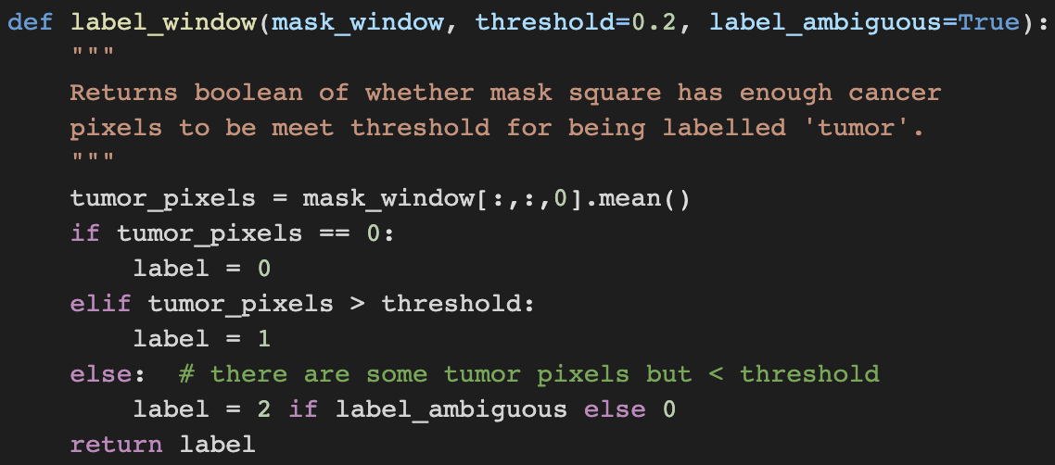
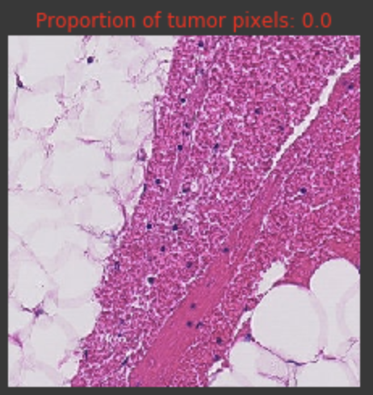

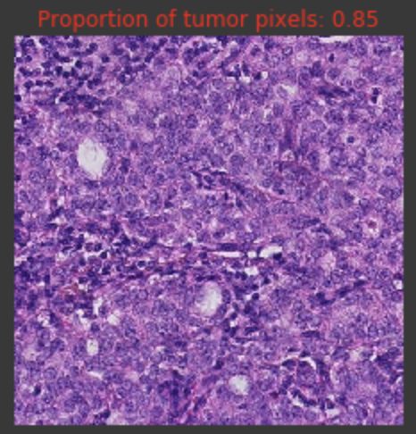

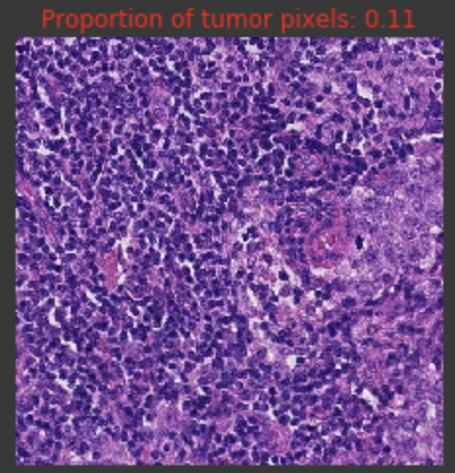

Label Windows
Build tool to label window as tumor or non-tumor
Added a third label for when number of tumor pixels < threshold, but > 0
Removed label 2 during training

Slide 10
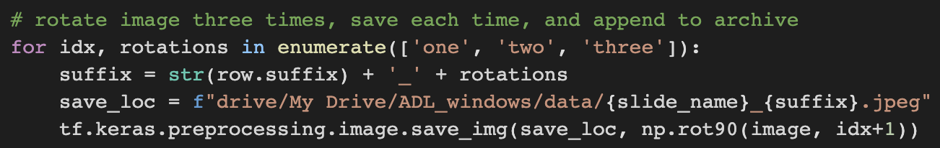
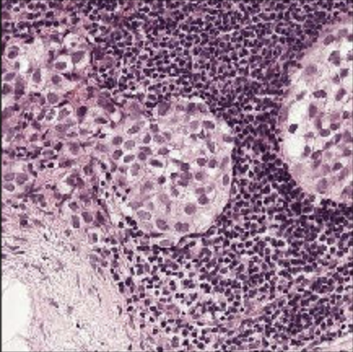
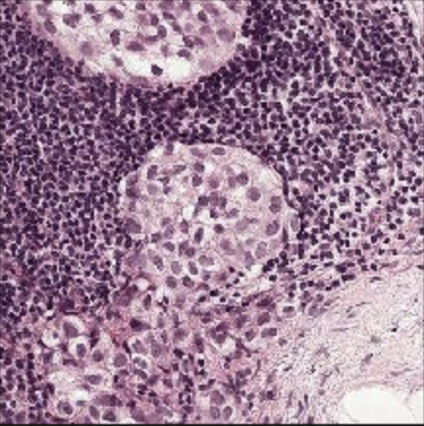
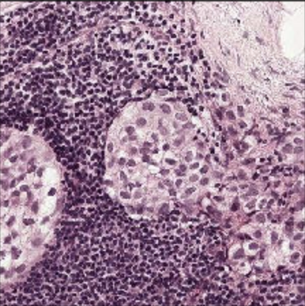
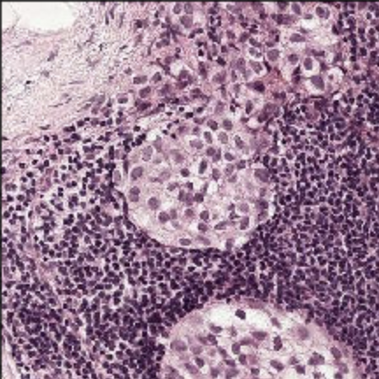
Augmentation
Class 0 vs. class 1 ratio was approximately 0.85-to-0.15
Rather than upsampling, we rotated all class 1 (tumor) images by 90, 180, and 270 degrees to quadruple class 1 sample size

Slide 11
MODELING

Slide 12
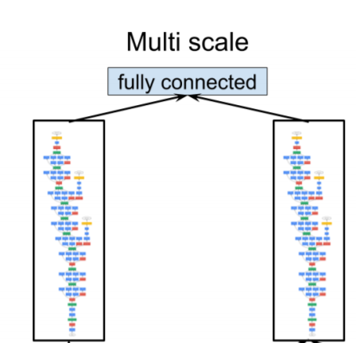
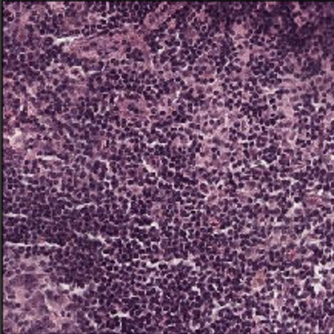
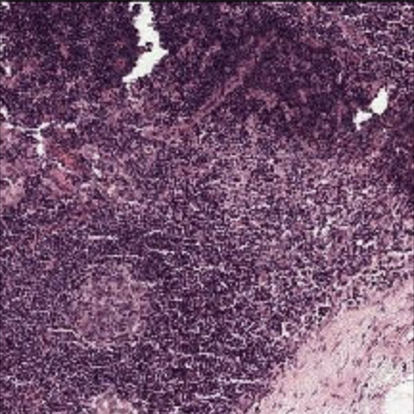
Architecture of Final Model
Multi-input (2) transfer learning using InceptionV3 and ImageNet weights for both inputs
GlobalAveragePooling2D() and a Dense(128, ‘relu’) layer were appended to outputs from each InceptionV3
The output dense layers were concatenated
A final Dense(128, ‘relu’) layer was added after the concatenation before the sigmoid activation output
Input for single training sample:
1) (300, 300, 3) level 2 window
2) (300, 300, 3) level 3 window with same center point
Level 2
Level 3
Detecting cancer metastases on gigapixel pathology images, Y Liu et al., arXiv preprint arXiv:1703.02442

Slide 13
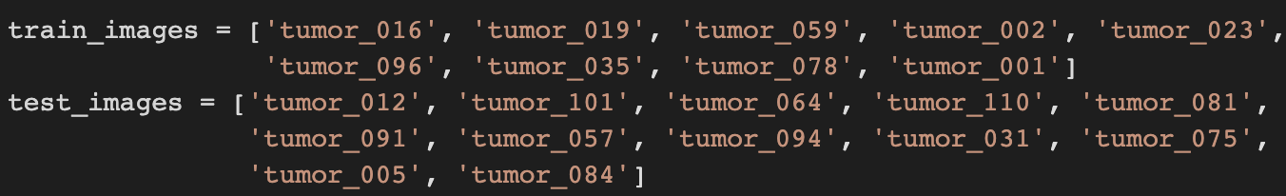
Training
Train-test split was made at image level
Split was made so tumor window proportions were approximately equal in both sets
Train set was downsampled further to be balanced
Yielded 8040 training windows
Trained for 20 epochs
Accuracy / Precision / Recall / AUC performance:
Training: 0.99 / 0.99 / 0.99 / 1.00
Validation: 0.75 / 0.79 / 0.66 / 0.82

Slide 14
Model Add-On
We found that while DNN model performance was respectable, independent nature of window predictions resulted in randomly located false positives / negatives
E.g. a single class 1 prediction inside a large cluster of class 0 predictions, which is unlikely in reality
To incorporate data from surrounding windows, we trained classifiers using the sigmoid outputs
Total feature space = nine probabilities (one for window of interest, eight for neighboring windows)
Needed to divide test set (12 images = 12) into new train (n = 9) and test (n = 3) sets
Best model: Logistic Regression

Slide 15
FINAL RESULTS

Slide 16
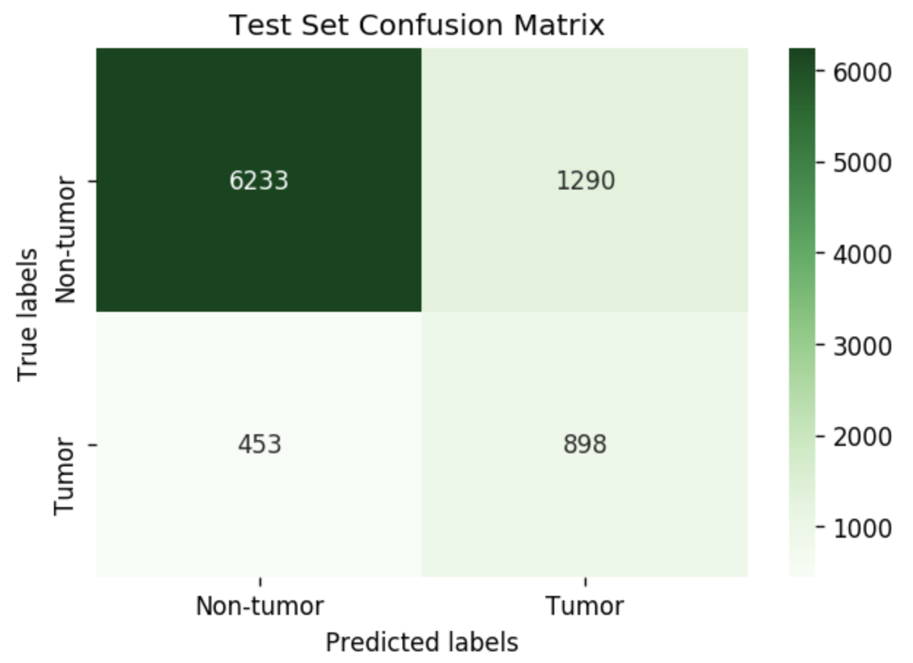
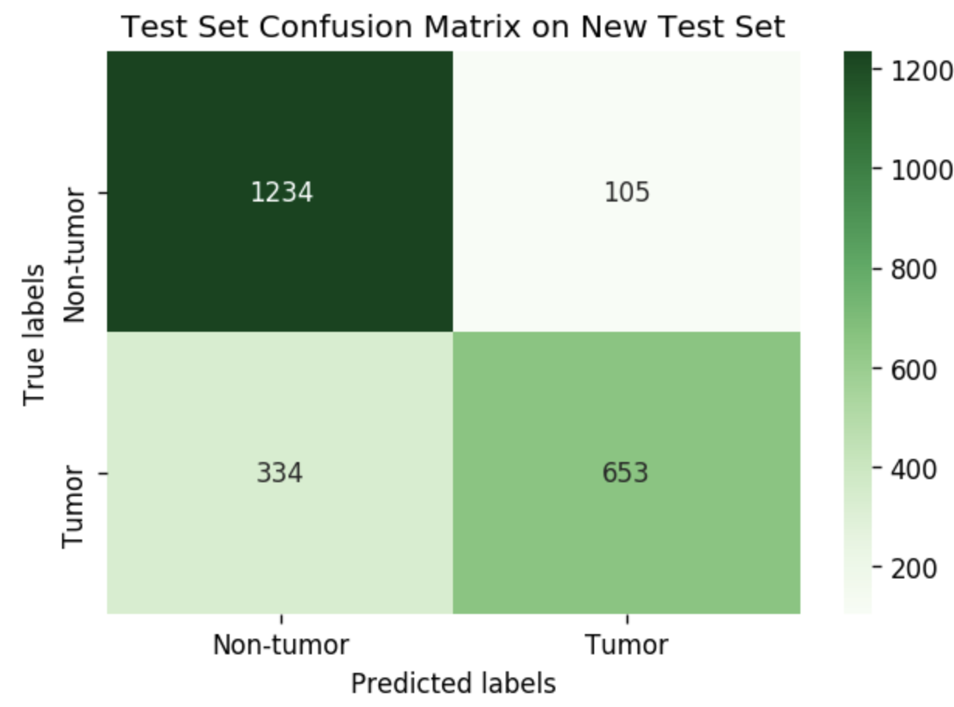
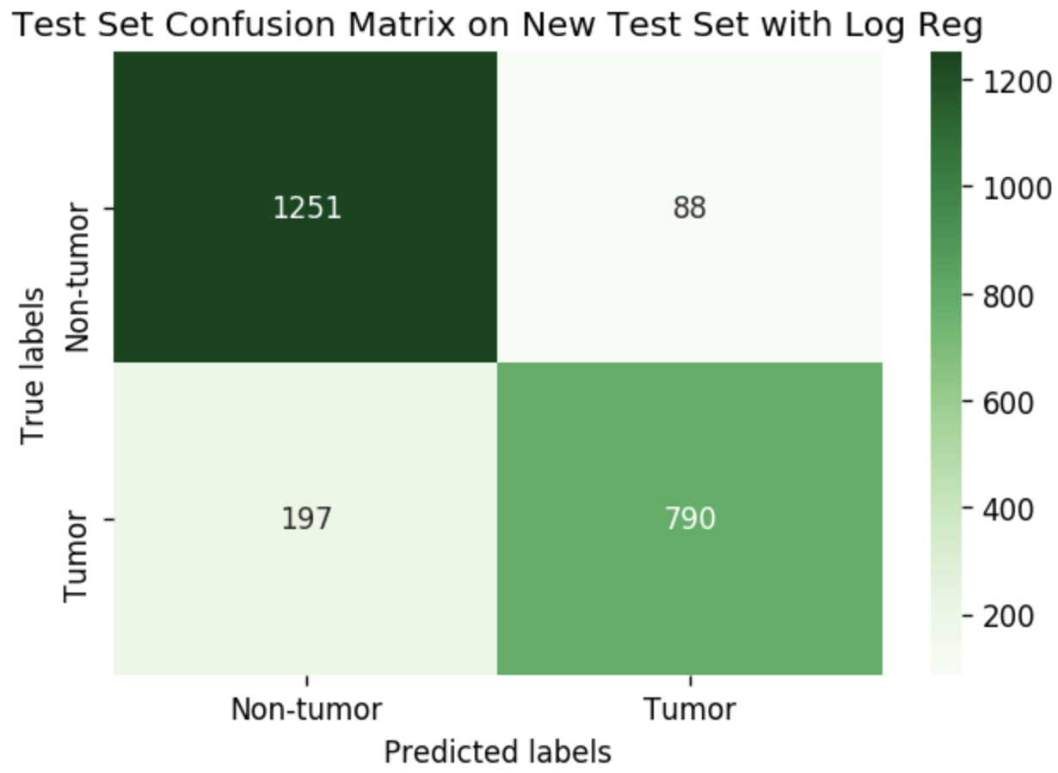
Metrics & Confusion Matrices
Model | Data Description | Accuracy | Recall | Precision
DNN | Complete test set 12 images with 8,873 windows | 0.80 | 0.66 | 0.41
DNN | Reduced test set 3 images with 2,326 windows | 0.80 | 0.66 | 0.86
DNN & Logistic Regression | Reduced test set 3 images with 2,326 windows | 0.88 | 0.80 | 0.90

Slide 17
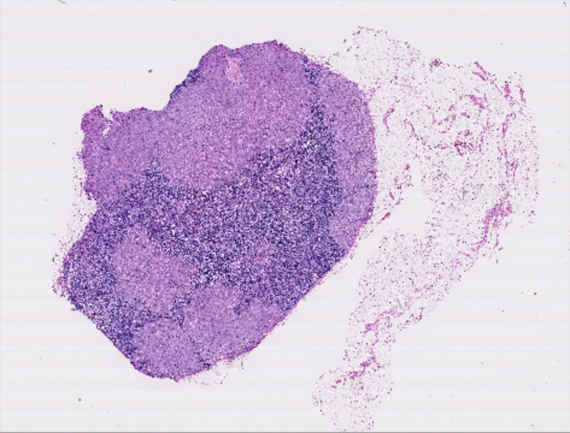


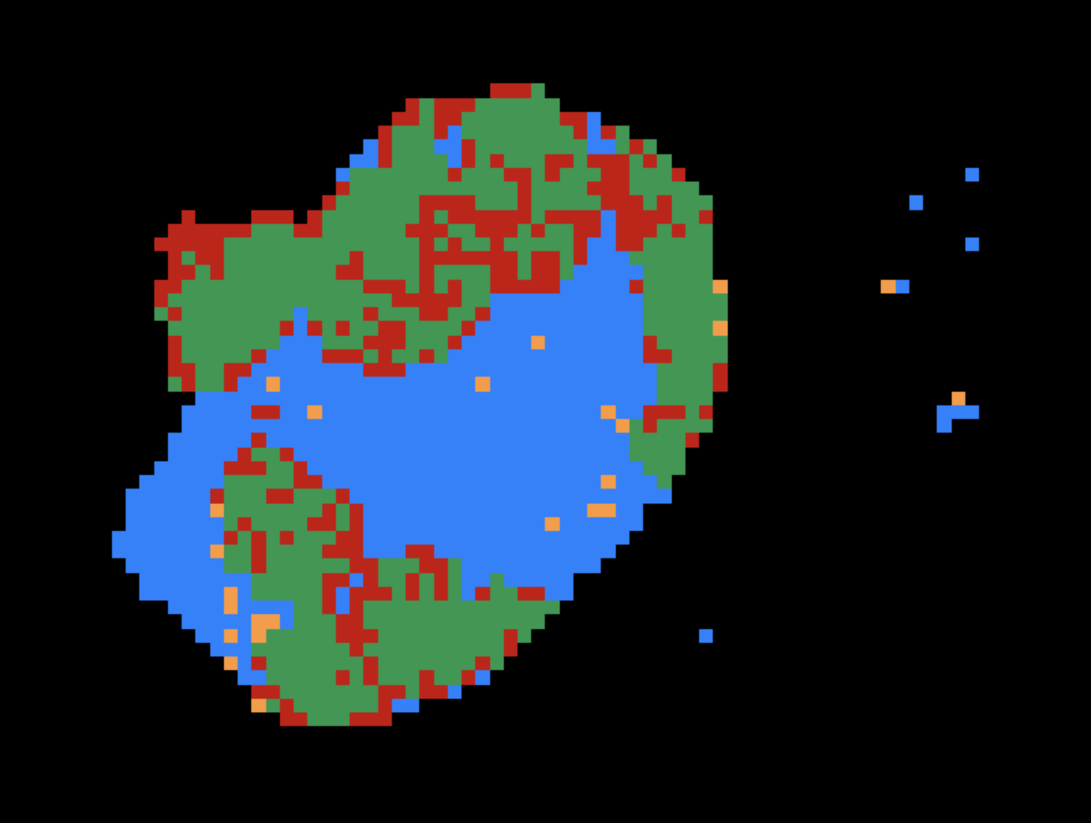

Heat Map for Tumor #110
Logistic Regression add-on significantly reduces noise
Predictions are now clumped into distinct islands
TN
FP
Full Slide
Mask of Tumor Cells
FN
TP
Heatmap Legend
Heatmap without Log. Reg
Heatmap with Log. Reg

Slide 18
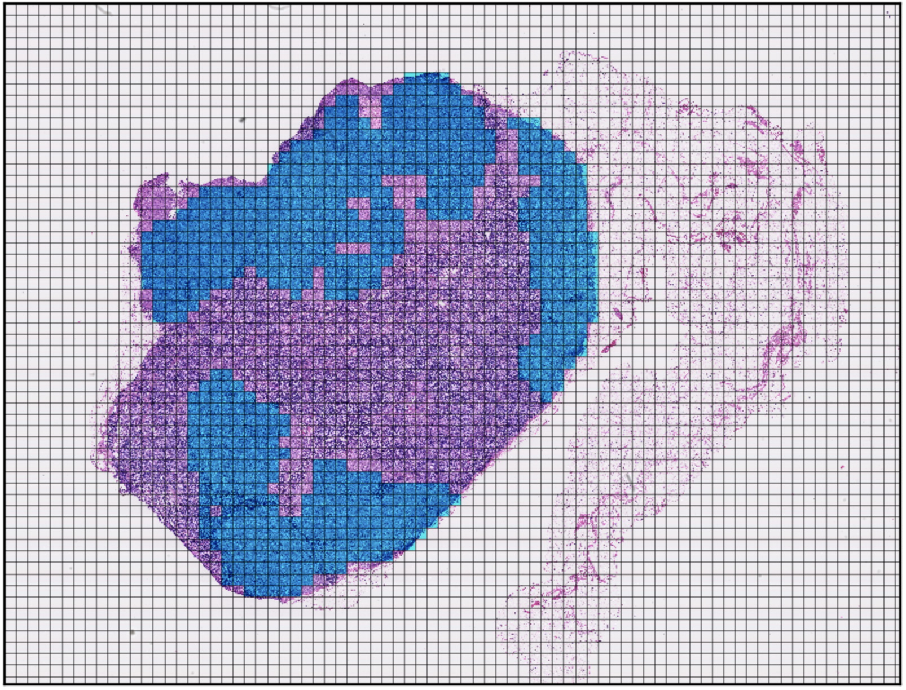
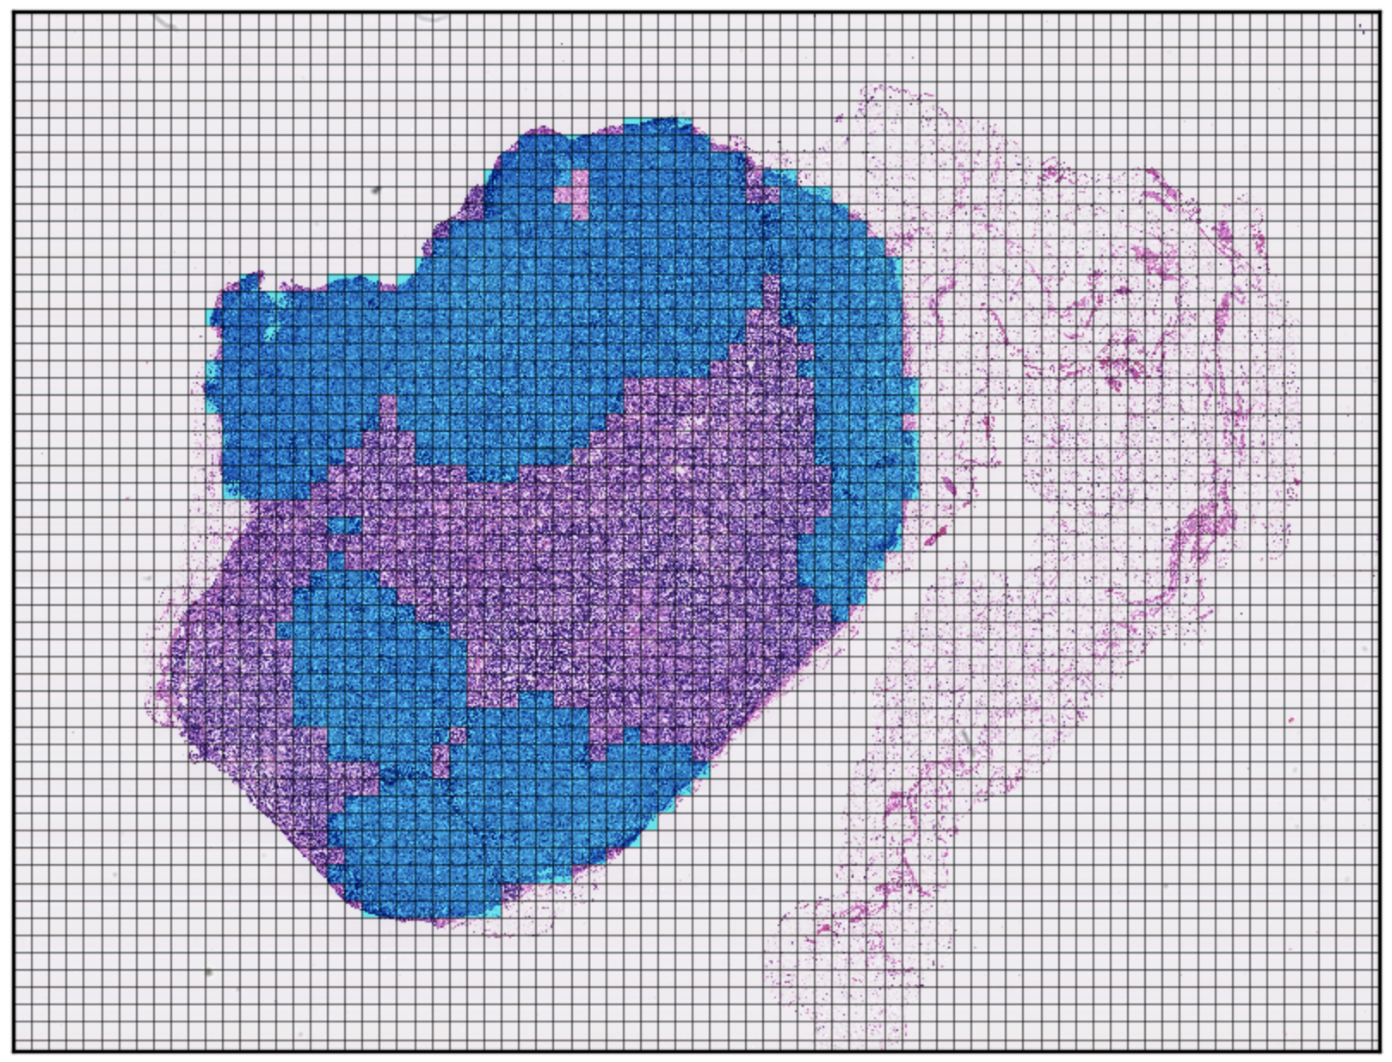
Heat Map for Tumor #110
Tumor Window Predictions
Tumor Window Ground Truth

